Slide 1
Fake News Detection
Here is where our presentation begins

Slide 2

Arjun Patel: 0812257 Aman Patel: 0812557 Harshil Patel: 0801869 Jay Gandhi: 0808579 Meet Shah: 0797050
Group 11
WHOA! WHOA! WHOA! WHOA! WHOA! WHOA! WHOA! WHOA! WHOA! WHOA! WHOA! WHOA! WHOA! WHOA! WHOA! WHOA! WHOA!

Slide 3
CONTENT
Methodology and Model Selection
Project Overview
Web Application using HTML and CSS
Project Objective
Problem Statement
Future Work

Slide 4
02
Project Overview

Slide 5
Project Overview
GOAL
IMPORTANCE
Our goal is to create a robust system to detect and filter fake news online, using advanced machine learning and natural language processing.
By deploying this system, we aim to foster a more trustworthy online environment, ensuring users have access to accurate information.
Our project works against fake news to keep online information honest and trustworthy.
By spotting fake stories, we keep communities and businesses safe. We help people think carefully about what they read, so they can tell what's true. In the end, we make sure online information is clear and helps people make good choices.

Slide 6
03
Project Objectives

Slide 7

"Our project's main objective is to create a reliable and effective system that can precisely recognize and classify false information found in textual content. By combining cutting-edge machine learning algorithms with natural language processing
methods, we hope to provide consumers with a tool that will help them tell the difference between trustworthy sources and false stories. Our initiative aims to contribute to the continuing efforts in reducing the detrimental effects of fake news on people and society at large by attaining high levels of precision and recall."

Slide 8
04
Problem Statement

Slide 9
PROBLEM STATEMENT
Nowadays, fake news is a big problem online because false information can quickly spread. It's tricky to know what's real and what's made up because fake stories are so common, and it's tough to catch them all.
Plus, there are not many examples of fake news for computers to learn from. That's why we are working on creating smart tools that can spot misleading parts in news articles. These tools will help people decide if what they are reading is true or not, so they can be smarter about what they believe online.
Earths is the Sun’s mass

Slide 10
05
Methodologies & Model Selection

Slide 11
METHODOLOGIES AND MODEL SELECTION
Data Preprocessing
Data Collection & Modification
Mixed fake and real news datasets, all cleaned up and formatted alike for easy use.
Additionally, a new "label" column was introduced in each dataset, designating 0 for fake news and 1 for genuine news.
Stop Words Using Corpus and Spacy
We utilized both the NLTK and SpaCy libraries to gather stop words from their respective corpora. These stop words were then employed to eliminate unnecessary words from our text column, enhancing the quality of our text data.

Slide 12
METHODOLOGIES AND MODEL SELECTION
Word2Vec
Tokenization through Word2Vec
We conducted tokenization on our text column using Word2Vec by splitting the text into individual words or tokens, and subsequently built a vocabulary of these tokens using Word2Vec methods, enabling us to represent words as dense vectors for further analysis.
Word2Vec Vectorizer & Random Forest Classifier
Word2Vec Vectorizer:
We used Word2Vec to turn text
into numbers, making it easier for
machines to understand and analyze.
Random Forest Classifier:
We chose the Random Forest Classifier
for its robustness in fitting our data and
delivering high accuracy and making it a
suitable choice for our analysis.

Slide 13
06
Web Demo

Slide 14
WEB APP
Our web Application of Fake News Detection utilized HTML, CSS3, and Flask to create a dynamic and visually appealing user experience. HTML provided the foundational structure for our webpage layout.
We paid particular attention to detail in CSS3, selecting fonts that complemented our content and creating a cohesive color scheme to convey our brand personality.
In the backend, we leveraged Flask, a lightweight Python microframework, to create a robust web model.
Flask facilitated seamless communication between frontend and backend components, enabling efficient data
processing and dynamic content generation.
Overall, our integration of HTML, CSS3, and Flask resulted in an intuitive, visually appealing, and functional web application that meets the needs of our users.

Slide 15
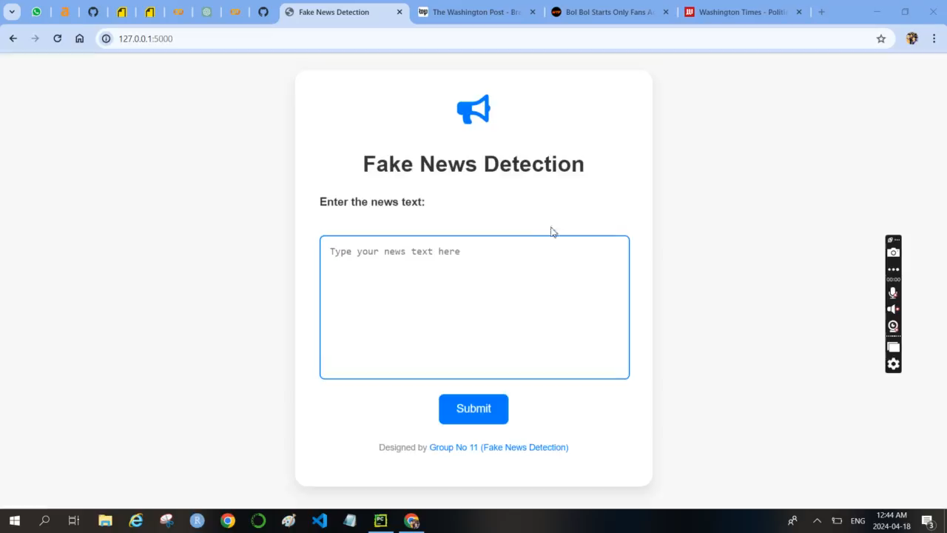

Slide 16
07
Future Work

Slide 17
Future Work
This application will serve as an interactive platform where users can easily access our fake news detection system. By integrating our system into this platform, we aim to enhance user-friendliness and ensure scalability for future needs.
In future work, we aim to explore advanced natural language processing techniques and incorporate deep learning models to further enhance the accuracy and robustness of our fake news detection system.

Slide 18


